Slide 1



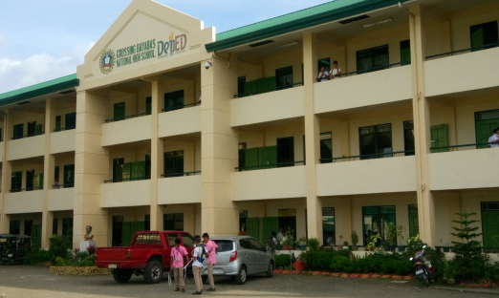
HiSRMS v2.0 Manual
General User Guide for Dummies

Slide 2
Table of Contents

Slide 3
General Terms
Module/System/Application – refers to the program/software installed.
Database – storage for all the data contained inside the system.
Access Level – refers to a user’s access to a certain program. Access to certain features are restricted to lower levels, while higher levels have less-to-no feature restrictions.
Administrator (Access Level 5) – has full control of the entire system without any restrictions. It is recommended that the School’s IT Personnel should only have administrator accounts for troubleshooting bugs.
Registrar (Access Level 4) – has full control of the entire system with minimal restrictions on each module. The School’s Registry personnel are the recommended users since handling school records are handled and submitted to them.
Curriculum Head (Access Level 3) – has access to Registration System only. He/She is responsible for managing subjects, curriculums and managing Department Head users.
Department Head (Access Level 2) – has access to Grading System only. He/She is responsible for approving grades submitted by advisers during grading period before the Registrar closes the submission.
Teacher/Subject Teacher/Adviser (Access Level 1) – has access to most modules, but limited to basic or advisory work features only. Majority of the School’s staff are the users of this system.

Slide 4
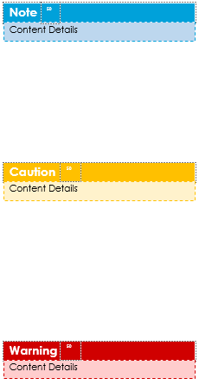
Information Message Types
Some important information must always be highlighted in a manual for the user to keep it in mind. The effect it has on the system and how it functions is determined by the colors of the message boxes below
Note Boxes – shows important information about a particular feature where consequences of not following it will not greatly impact the system while running. It mostly consists of tips and tricks on using the system properly.
Caution Boxes – shows information that should be given attention and rules to be strictly followed by the user. Although it may not cause the system to fail, it may cause a small amount of inconveniences to the user when using the system.
Warning Boxes – information inside these boxes should not be ignored. Ignoring these messages might greatly affect the system and may cause it to not work properly and inconvenience other users using it. Ignoring instructions indicated here should only be done under the supervision of the qualified IT Personnel handling this system.

Slide 5
Order of Usage of the System

Slide 6


HiSRMS Launcher
01
Opens and manages the modules used by the entire system. It also manages the variables used for processing the records inside other modules.

Slide 7
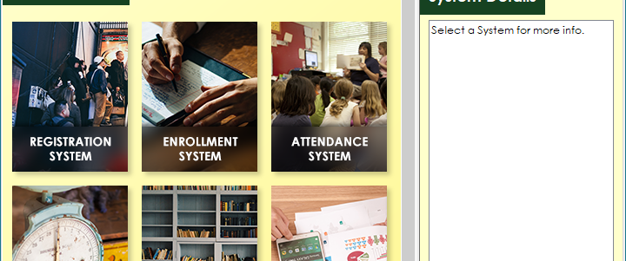
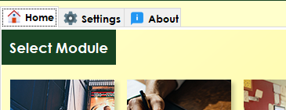
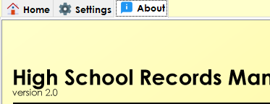

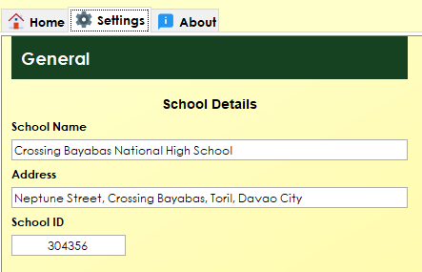
The General User Interface
1. Home Tab
3. About Tab
Contains all the applications/modules installed on the system (7 in total).
Shows detailed information about the software.
2. Settings Tab
Note
Running a module will minimize this window.
Only one instance can only be opened per module. (ex. You can’t open two Registration windows at the same time)
On the Settings Tab, under Performance category, the IP Address field shall be provided by the IT personnel of the school.
Contains modifiable variables that will be used by the other applications when processing data.

Slide 8


Registration System
02
Stores the list of students, teachers, and subjects of the entire school. At the beginning of a school year, this application should be the first one used to register new incoming students and staff during pre-registration or enrollment.
Registrar and Curriculum Head users only are allowed to access this Module.

Slide 9
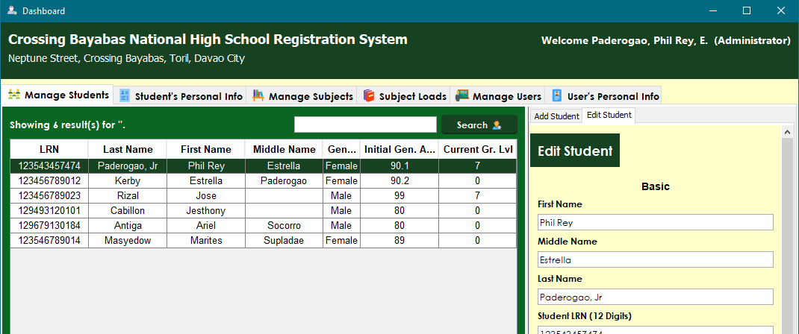
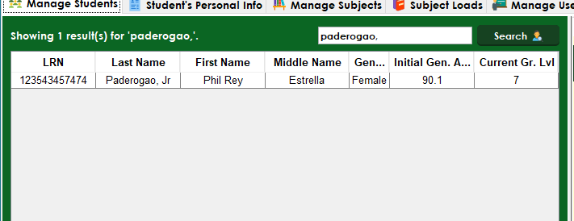
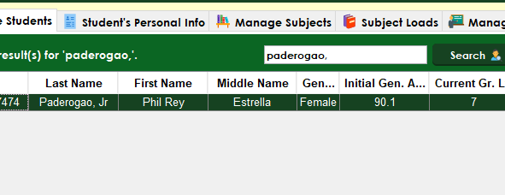
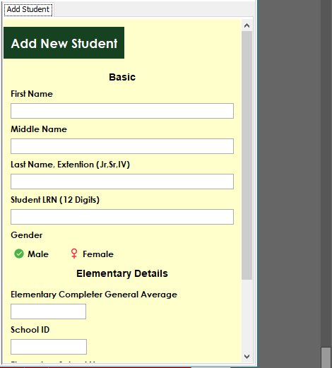
The User Interface
1.0 Manage Students Tab
1.2 Editing existing Students
Shows a list of all the students registered in this school.
Search for a student using the search bar.
Double-click on the student selected.
1.1 Adding Students
Note
Middle Name and Extension Name fields are optional.
A first time student registered in this school will have a current grade of 0.
Click on the Add Student tab under Manage Students.
Fill-up all the required fields.
Save changes and add new student.

Slide 10
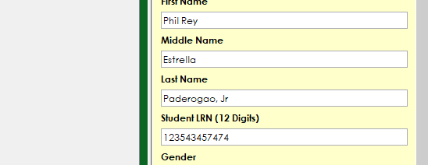

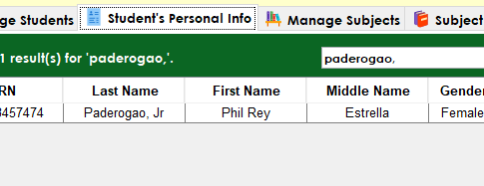
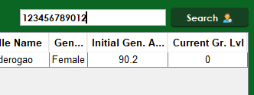
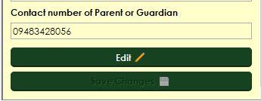
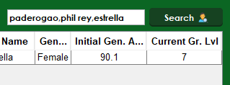
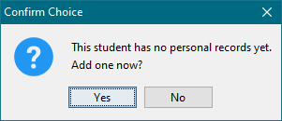

Warning
In case of saving a record with inappropriate special characters, please remember the details of your input and contact your School’s IT Personnel to help resolve the issue.
After selecting a student, an Edit Tab will pop-up on right side near the Add Student tab showing the current student’s details.
Modify and save your changes.
2.0 Student’s Personal Info Tab
Note
When using the search bar looking for students, you can use the Student ID or Full Name method.
When using Student ID method, type the student’s exact student id in the search bar.
When using Full Name method, type in the student’s name in order separated with a comma. It should be written in a last name, first name, middle name order.
These methods are used in all modules globally when doing a student or teacher search.
Manages personal information of students.
2.1 Editing Personal Details
Search for the student you want to edit.
Double-click on the student. Their details will show-up on the right side of the screen.
To edit, press the Edit button below.
Modify and save your changes.
Note
When a student has no personal records in the database, a prompt will pop up.
When putting personal details of a student, if there are still incomplete fields, you can leave them blank.
Caution
When typing details, please make sure there are no inappropriate special characters included on the information provided.

Slide 11
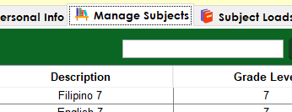
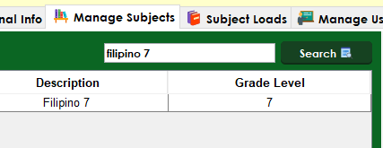
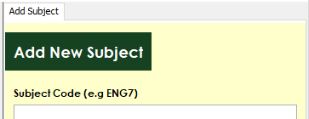
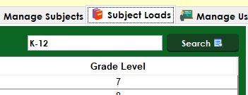
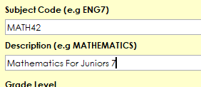
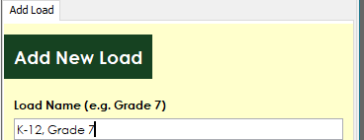
3.0 Manage Subjects Tab
3.2 Editing existing Subjects
Manages all the subjects the school has, ranging from grade 7 to grade 10 only.
Find an existing subject using the search bar. You can search a subject via Subject Code or Subject Name/Description.
Double-click on the subject and an Edit Subject tab will pop up on the right side of the screen beside the Add Subject Tab.
Modify and save your changes.
3.1 Adding new Subjects
4.0 Subject Loads Tab
On the right side of the screen, you will see an Add Subject tab where you will make a new subject to the database.
Fill-up all the required fields and save your new subject.
Note
When filling up the description field of the subject, it is recommended to put the grade level after the subject’s full name. Typing it without the grade level is also fine.
Show a list of loads that has a set of subjects that a section should contain.
It can also be called as a curriculum or strand, depending on the student’s grade level.
4.1 Creating new Subject Loads
Caution
It is recommended that Subject Codes should have unique names and must not have duplicates.
Only Advisory Subjects should always have a code of ADV with its corresponding grade level. (ex ADV7)
On the right side of the screen, you will see an Add Load tab where you will make a new subject to the database.
Fill-up all the required fields and save your new subject load.

Slide 12
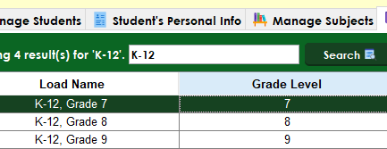
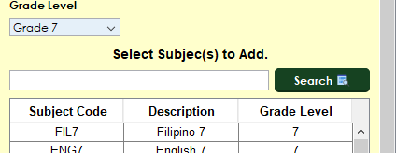
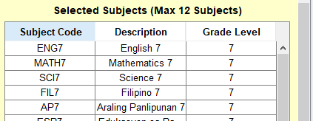
4.2 Editing a Subject Load
Note
You can select multiple subjects to add or remove from the list.
A load cannot have 2 or more subjects with the same name.
Caution
Find loads using the search bar.
Double-click on the selected load and an Edit Load tab will pop-up on the right side of the screen.
Modifying an existing load will give you additional options to modify below. This is where you’ll assign a set of subjects inside this load.
The first table is where the list of subjects available on the database is found. You will select the subjects you would want to add from this list.
Click on a subject and press Add Button below to add it to the list.
The next table contains all the subjects the current load has. (12 subjects max excluding Advisory Subjects.)
If you misadded a subject, click on it and press the Remove Button below to remove it.
Save your changes.
The order of which you add the subjects to the load will be the same when it is written on the report card files.
The last 6 subjects must always be these subjects in exact order:
MAPEH
Music
Arts
Physical Education
Health
Advisory
Warning
Modifying a load while it is being already used by other sections is not advised. Removing existing subjects is also not advised.
Doing so might cause records related to the new/removed subjects to not be shown. Don’t worry because they’re only hidden, not deleted. You just have to add it back to the list.
If modifying is really needed, Please consult the School’s IT Personnel to help determine affected records after modifying it.
Modifying should only be allowed on unused loads, that no any sections are using and no students are enrolled on it. Preferably during registration and enrollment periods.
To start with, please make sure that the data you entered is correct in order to avoid these type of situations.

Slide 13
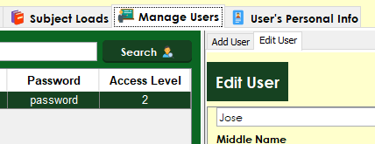
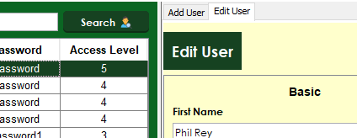
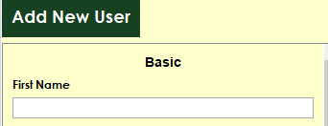
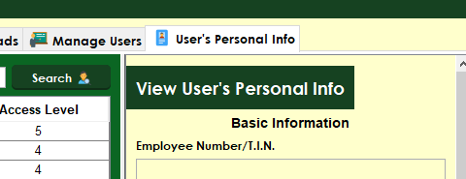
5.0 Manage Users Tab
5.2 Editing Existing Users
Shows a list of all the users registered and can use the system. (Non-teaching staff not included)
Users are sorted by their access levels in descending order.
Find users using the search bar.
Double-click on the selected user and an Edit User tab will pop-up on the right side of the screen.
Modify and save your changes.
5.1 Adding new Users
Caution
Modifying an existing user’s access level while in use will result in suddenly losing access to certain features when the user’s logins again.
If this event occurs, please visit your Registrar User or higher to change it back to its original settings.
On the right side of the screen, you will see an Add User tab where you will make a new user to the database.
Fill-up all the required fields and save your new user.
6.0 User’s Personal Info Tab
Note
User names must be unique while passwords are recommended to be a minimum of 8 characters long.
Manages personal information about all the users inside the system.
Information stored here will be used when exporting SF7 files.
Caution
In case of a forgotten password, please visit your School’s IT Personnel to recover your account details.
Administrator accounts’ access levels can be edited to level 4 below. But once changed, it can’t be reverted back to level 5. In case this event happens, please visit your School’s IT Personnel to revert the account back to its respective user level.
6.1 Editing Personal Information
Find users using the search bar.
Double-click on the selected user and the user’s information will show-up on the right side of the screen.
Modify and save your changes.

